Slide 1

Modern Control Theory
Lecture No. 20
The Bayesian Filtering Types
An Introduction to the Concept of Monte Carlo

Slide 2
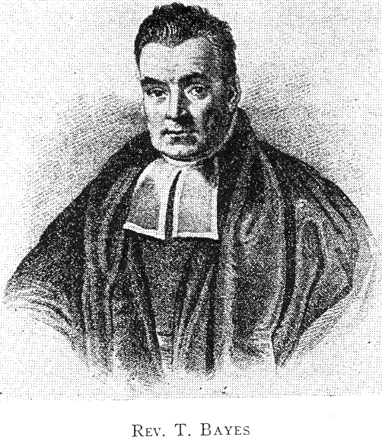


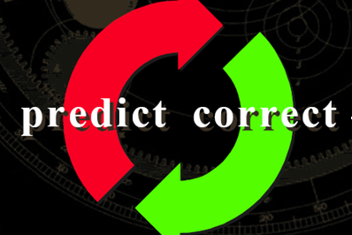
Bayesian Filtering : A Road Map for State Estimation
Type | Model Type | Type of Noise
Kalman Filter | Linear | Gaussian
Extended Kalman Filter | Non-linear | Gaussian
Unscented Kalman Filter | Non-linear | Gaussian
Particle Filter | Non-linear | Non-Gaussian
Unscented Particle Filter | Non-linear | Non-Gaussian

Slide 3
Components in a Bayesian Approach
State Vector : x_{k}
Measurement Vector: z_{k}
Initial pdf: p(x₀)
Likelihood pdf: (from model) p(z_{k}|x_{k})
Prior pdf: p(x_{k}|z_{1:k-1})
Posterior pdf: p(x_{k}|z_{1:k} )

Slide 4
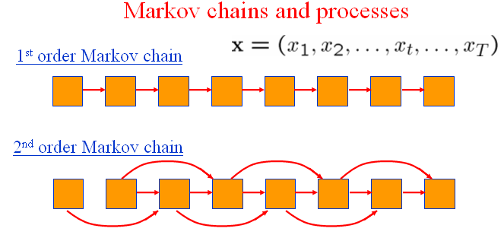
Bayesian Filtering/Estimation for Non-Linear Systems with
Non-Gaussian Process & Measurement Uncertainties
State Variable Representation of Dynamical Systems, which are Strongly Non-Linear

Slide 5
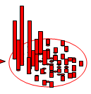
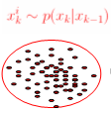
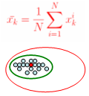



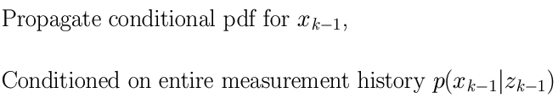
Particle Filtering --- Similar Recursions, but with a Difference
Instantiating
Re-sampling
X(k) = f[x(k-1), Bu(k-1)] + w(k-1)
Update
(k-1)+
(k)-
(k)+
k-1
k
z(k-1)
z(k)
X(k) = Ax(k-1) + Bu(k-1)

Slide 6

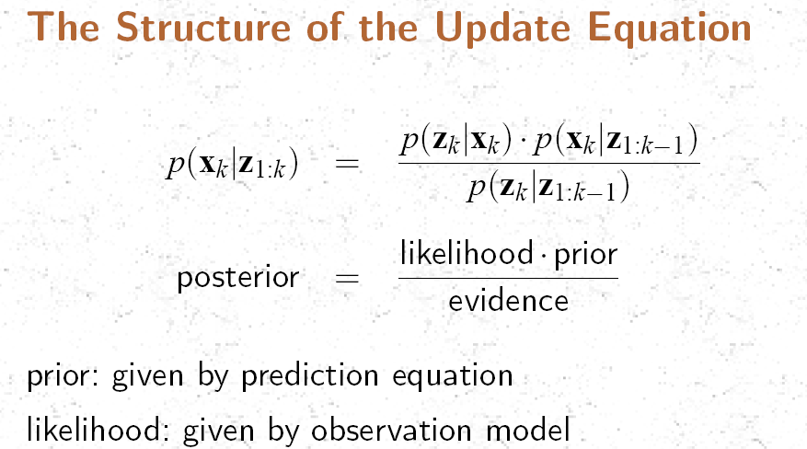

Slide 7
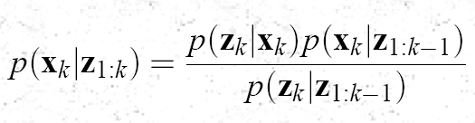


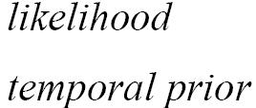

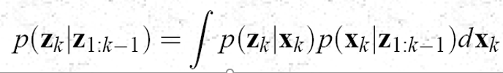

Slide 8
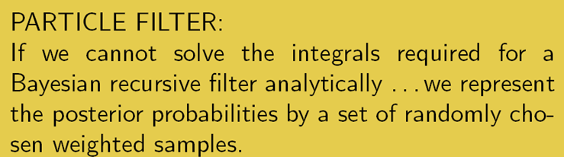
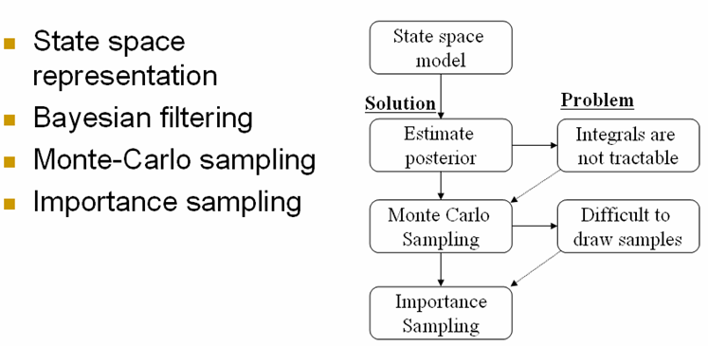

Slide 9
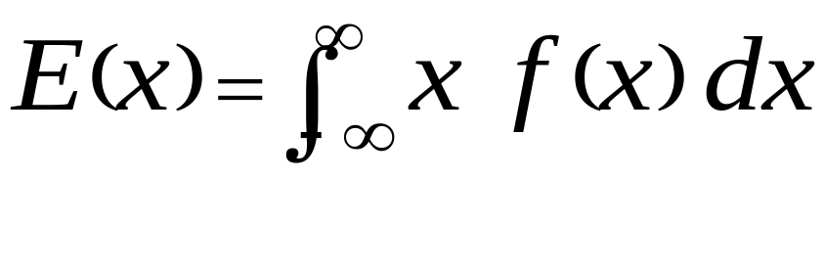
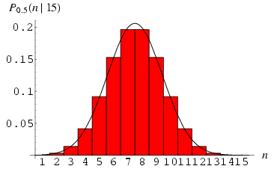
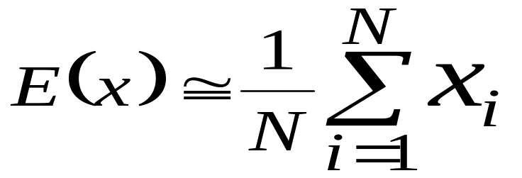
Monte Carlo Methods
Monte Carlo has 3 main usages:
Estimate Parameters or Statistical Measures
Examine the Properties of the Estimates,
Approximate Integrals
Less Theory, More Simulation

Slide 10
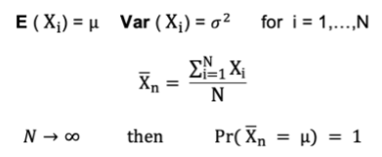
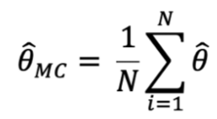
Monte Carlo & Law of Large Numbers
Monte Carlo uses the Law of Large Numbers (LLN) to come up with an estimate for a population parameter using simulated values.
LLN states: suppose X1, X2, . . . , Xn are all independent random variables with the same underlying distribution, also called independent identically-distributed or i.i.d,
  Where all X’s have the same mean μ and standard deviation σ.
  As the sample size grows, the probability that the average of all X’s is equal to the mean μ is equal to 1.
Consequently, the idea behind Monte Carlo estimation is that when we obtain an estimate for a parameter a large number of times
let’s say M = 10000 times, then the mean of these estimates will form a Monte Carlo unbiased estimate for that parameter

